Slide 1
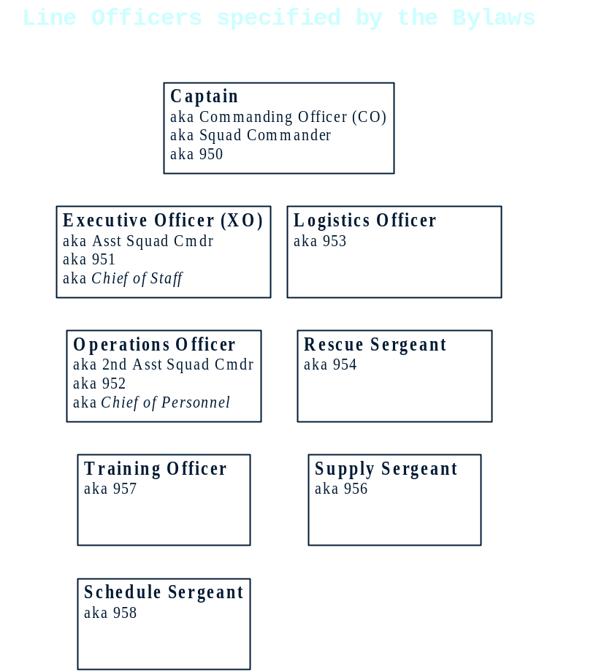
Understanding the Line Officer Realignment of 1999
Officers with command authority over personnel (the Captain, XO, and Ops officers) are elected by the membership. VBDEMS signifies its endorsement of this authority by issuing Blue ID Cards to these officers.
Officers without such authority are appointed by the Captain.
Squad Truck Supervisor
aka 930
Elected by the Squad Truck Team; has command authority over the team.
Any officer may appoint other assistants as necessary.

